Slide 1

Prepared by: Syed Mujtaba
FIFA World Cup DATA ANALYSIS

Slide 2

Contents
➤Introduction
➤Given Tasks
➤Data Preparation and Description
➤Visuals
➤About Tools and Theme
➤Analysis

Slide 3
Introduction
➤ With FIFA being in the blood as many people of the world. You are tasked to tell the story of unsung analysts who put great efforts to provide accurate data to answer every question of fans.
The FIFA World Cup is a global football competition contested by the various football- playing nations of the world. It is contested every four years and is the most prestigious and important trophy in the sport of football.
The World Cups dataset show all information about all the World Cups in the history,while the World Cup Matches dataset shows all the results from the matches contestedas part of the cups.
➤ Advantage : Analyst can easily show about the highest FIFA World Cup winner through the FIFA history in terms of how many titles each team won.

Slide 4

Write the process the data manipulated using pandas. In addition,mention the theme on which you will be creating the
02 Dashboard.
01
Applied some formulae on the data using excel.
Given Tasks
Do the Data Preparation part.
03
Build the Dashboard.
04
05
Build a Storyline

Slide 5
➤Data was given into three parts : (1WorldCupMatches
Data Preparation & Description
(2) WorldCupPlayers (3)WorldCups .
➤I did some data analyzing in pandas to understand the data.
➤Some of the attributes were not useful so I used the main attributes.
➤Made some of the tables on pandas itself so that helped me in making visualization.
➤Data is in form of numeric and alphabets
➤Then using this data I made all the visualization

Slide 6
KPIs (Key Performance Indicators)
Top World cup winners.
Most no. of world cup winning team.
Highest no. of runner up titles.
Highest no. of third titles.
Highest no. of fourth titles.
Qualified teams as per year.
Matches played as per year.
Stadium with max no. of attendance.
Matches with max no. of attendance.
Total away team goals.
Total home team goals.
Matches outcome by home team and away team

Slide 7




TOOLS USED

Slide 8

Theme
Most Titles won by the Teams in FIFA History

Slide 9
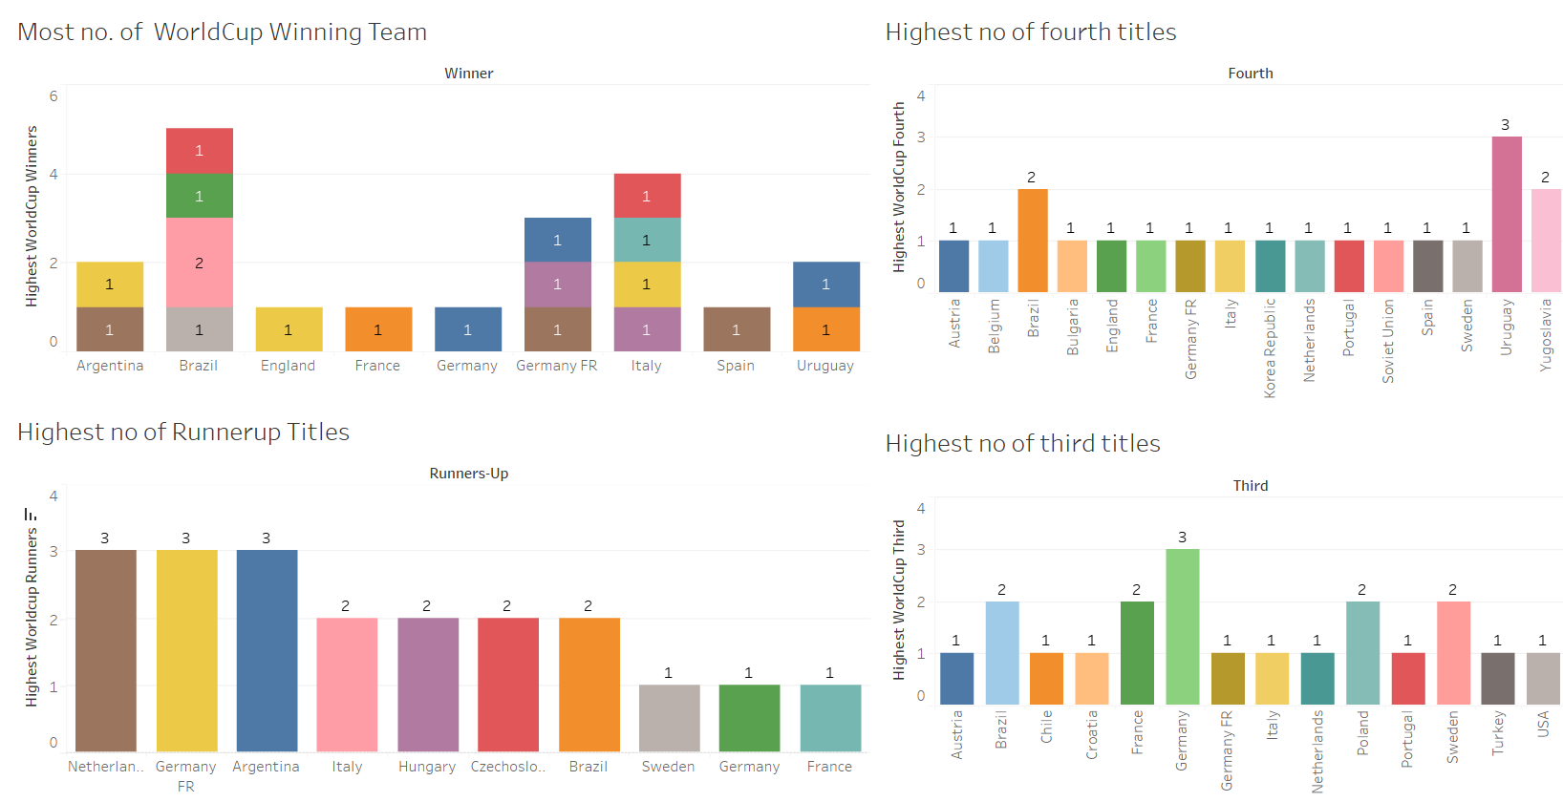
Dashboard 1
➤ Top Winning titles are shown in this dashboard.
➤This Bar chart shows the most no. of World Cup Winning Team.
➤ This Bar Chart shows the most no. of runner-up Team means the teams who got the most runner-up titles.
➤ This Bar Chart shows the most no. of Third Team means the teams who got the most Third Titles.
➤ This Bar Chart shows the most no. of Fourth Team means the teams who got the most Fourth Titles.

Slide 10
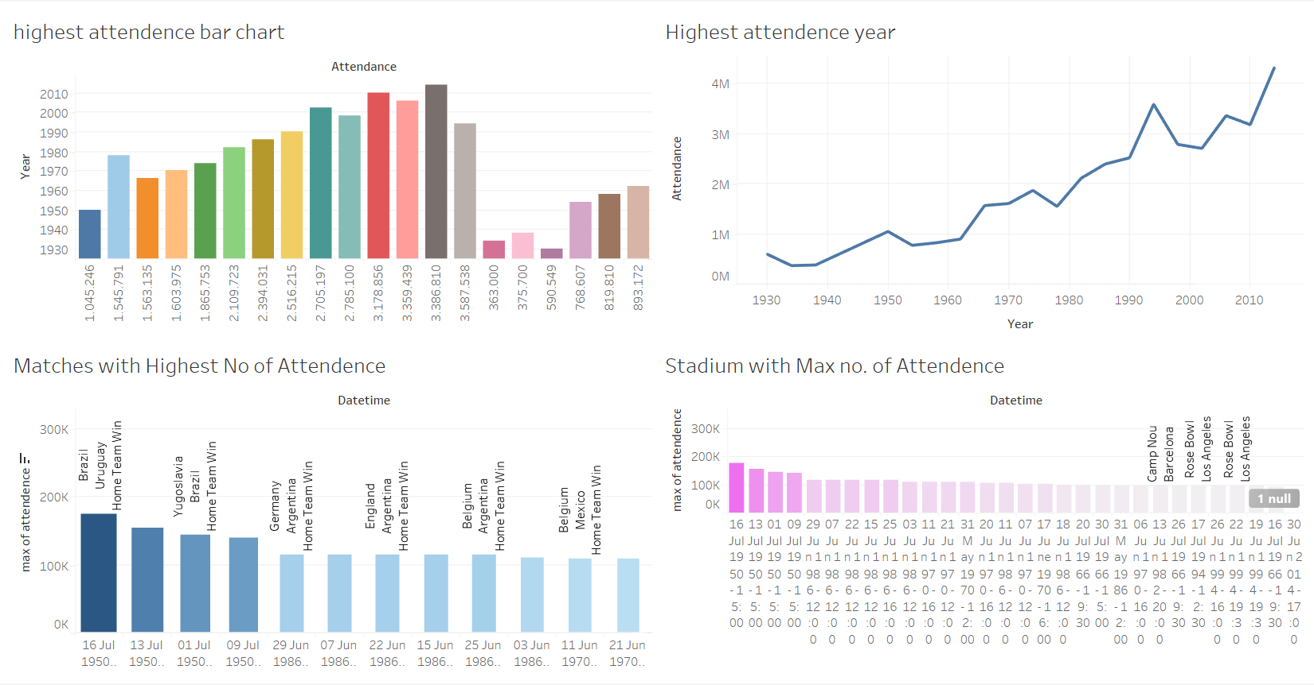
Dashboard 2
➤ Dashboard 2 is about the Attendance of the matches and stadium.
➤ This bar chart shows the Attendance of the overall World Cup Years.
➤ This Line Graph shows the Attendance of the overall World Cup Years.
➤ This Bar chart shows the Matches with Highest Attendance over the years.
➤ This Bar chart shows the Stadium with Highest Attendance over the years.

Slide 11
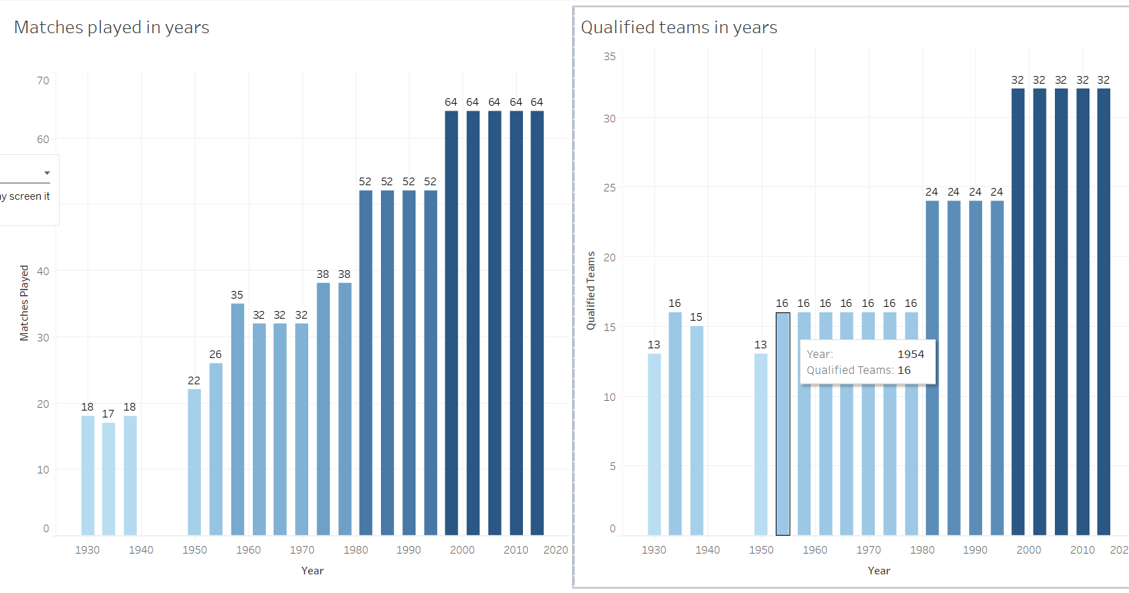
Dashboard 3
➤ Dashboard 3 is about the Matches played in years and qualified team in year.
➤ This Bar chart shows the matches played over the years.
➤ This Bar chart shows the Qualified Teams over the years.

Slide 12
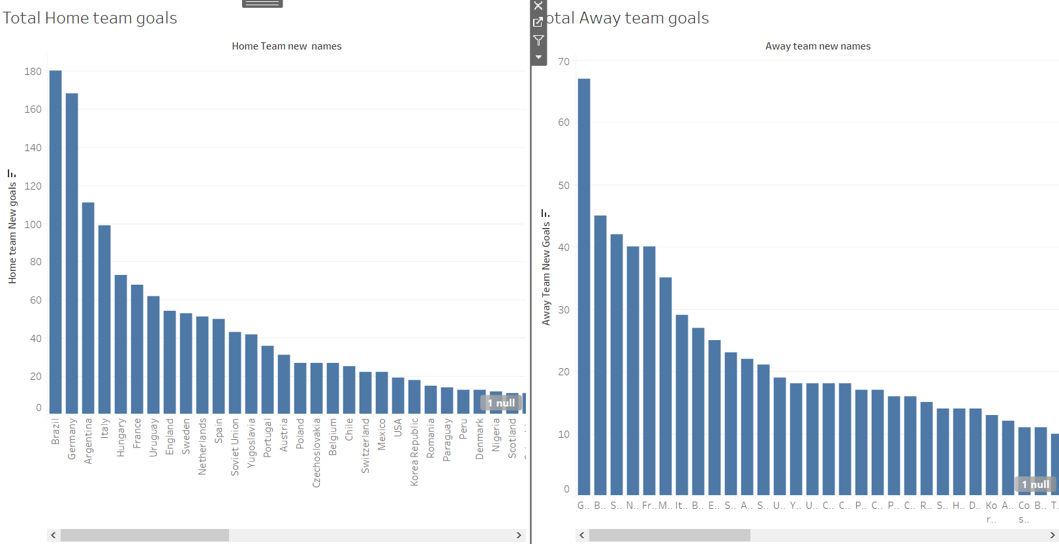
Dashboard 4
➤ Dashboard 4 is about the goals of home team and away team which indicates about every team
➤ This Bar chart shows the total goals of each and every team when they were Away team.
➤ This Bar chart shows the total goals of each and every team when they were Home team.

Slide 13

Thank you!
To those who Saw this and Contributed their Interest.

